Slide 1
Cell Tower Capacity Planning
By:
T Shubham
Gaurav Jain
Rajvardhan Jadhav
Yashraj Verma
Data Mining & Predictive Analytics Approach
Under the guidance of: DR. HEMANT RATHORE

Slide 2
Contents
Motivation
Objectives
Data Source
Performance Metrics
Problem Statement and Github Link
Methodology
Conclusion

Slide 3
Motivation
Increasing mobile data usage requires efficient network planning
Overloaded towers cause dropped calls and poor internet experience
Operators need predictive tools for proactive decision-making
Data-driven planning ensures better QoS and cost optimization

Slide 4
Objectives
To present a data-driven framework for cell tower capacity planning.
To explain how data mining techniques (forecasting, anomaly detection, clustering, optimization) can help.
Predict future traffic load.
Detect capacity breaches early.
Identify geographic hotspots & blind spots.
To show how a serverless AWS architecture with Step Functions can automate this end-to-end workflow.

Slide 5
Data Source
Approach-1: Dataset : Time Series Forecasting Attributes: baseStationIndex, cellIndex, beamIndex, mode, channel, partner, dl_count, dlr_count, dlp_rate, rb_rate, date
Approach-2: Dataset : OpenCellID - Ireland
Attributes: 'radio', 'mcc', 'mnc', 'lac_tac', 'cell_id', 'samples', 'longitude', 'latitude', 'range'
Approach-3: UCC - 4G LTE Network
Dataset - : Cellular Network Analysis
Attributes: 'timestamp', 'longitude', 'latitude', 'speed', 'operatorname', 'cellid', 'networkmode', 'rsrp', 'rsrq', 'snr',

Slide 6
Performance Metrics
Utilization % → shows how much of the tower’s capacity is being used.
Latency (ms) → measures delay, increases as towers get congested.
Packet loss (%) → % of data packets dropped, impacts browsing/streaming.
Dropped call rate (%) → user experience measure, higher when network overloaded.
Signal strength (RSRP) → indicates coverage quality from the tower.
SINR (Signal-to-Interference + Noise Ratio) → shows how clean the signal is compared to noise and interference.

Slide 7
Problem Statement and Github Link
Mobile networks face uneven traffic distribution across towers
Traditional reactive methods lead to late upgrades
Need predictive models to forecast demand and detect anomalies
Must identify geographic hotspots for optimized tower placement
Project Link - https://github.com/gaurav-2408/cell-tower-capacity-planning

Slide 8
Methodology
1
2
3
Time-Series Forecasting
Anomaly Detection
Object Clustering & Geospatial Analysis
Predict future tower traffic
- Seasonal Naive, Prophet, Linear Autoregression
Spot sudden spikes or drops
- Isolation Forest, Autoencoders
Group towers, find hotspots
- K-Means, DBSCAN, Hexbin maps

Slide 9
Cell Tower Capacity Forecasting : Time Series Approach
Problems & Approach
Cell tower traffic fluctuates over time → risk of overload or under-utilization.
We use time-series forecasting to predict future traffic patterns at the beam (cell tower channel) level.
Dataset: Beam-level traffic data (split into train weeks and test weeks).
Models tested:
Seasonal Naive (simple baseline, repeats last week’s pattern).
Prophet (captures trend + daily/weekly seasonality).
Linear Autoregression (AR) (uses past values + time features).

Slide 10
Cell Tower Capacity Forecasting : Time Series Approach
Workflow & Evaluation
Step 1: Data check (decode_as_entries.py) → ensures dataset availability.
Step 2: Model training + forecasting (seasonal_naive_forecast.py).
Step 3: Unified evaluation (predict_accuracy.py) → compares all models.
Metrics: MAE, RMSE, WAPE, sWAPE, Median AE.
Outcome: Identifies the most accurate forecasting approach for network planning.

Slide 11
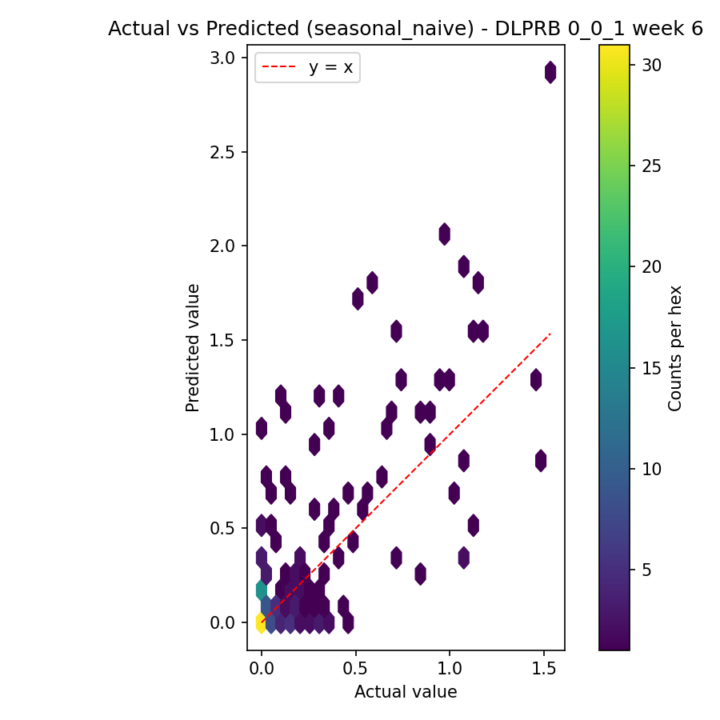
Cell Tower Capacity Forecasting : Actual v/s Predicted For week 06
Axes:
X: Actual value
Y: Predicted value
Red dashed line y = x: perfect predictions
Colorbar: count of points in each hex
Points on the red line → perfect; above → overprediction; below → underprediction.
Most density is near actual ≈ 0, with many predictions above the line there → the model tends to overpredict at low actuals.
A few higher-actual points spread out; overall scatter is wide, explaining large percent errors despite modest absolute errors.

Slide 12
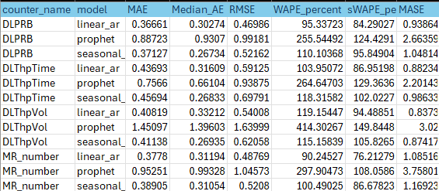
Cell Tower Capacity Forecasting : Benchmark Results Summary by Performance Indicator

Slide 13
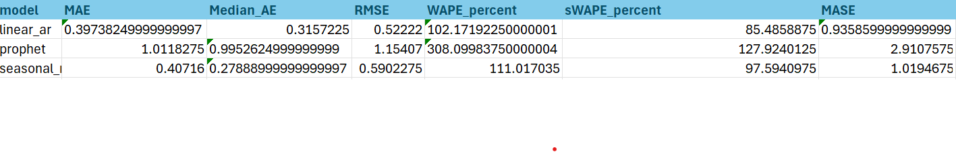
Cell Tower Capacity Forecasting : Benchmark results Summary by Model
MAE Mean Absolute Error – lower is better.
Median_AE Median Absolute Error – less sensitive to outliers, lower is better.
RMSE Root Mean Squared Error – penalizes large errors more, lower is better.
WAPE_percent Weighted Absolute Percentage Error – a percentage version of MAE, lower is better.
sWAPE_percent Symmetric WAPE – similar to WAPE but normalized, lower is better.
MASE Mean Absolute Scaled Error – compares model error to a naive forecast; <1 means model is better than naive.
Insights from the Table:
Linear AR model has the lowest MAE, RMSE, and MASE (<1) → best performing model overall.
Seasonal model is slightly worse than Linear AR but still much better than Prophet (especially on MASE).
Prophet model shows the highest error across all metrics (WAPE > 300%, MASE ~2.9) → worst performing model.

Slide 14
2. Anomaly
Detection
Detects unusual spikes/drops in usage
Techniques: Isolation Forest, Autoencoders, Z-Score
Identifies outages, events (concerts, emergencies)
Prevents disruptions with early alerts

Slide 15
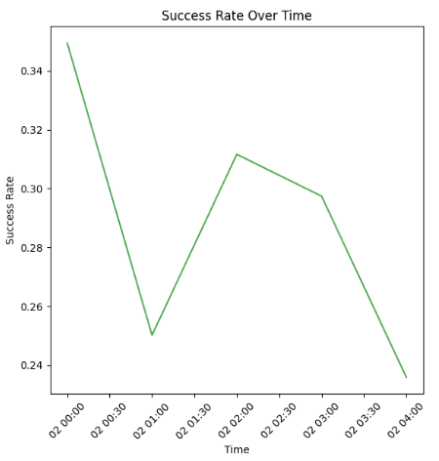
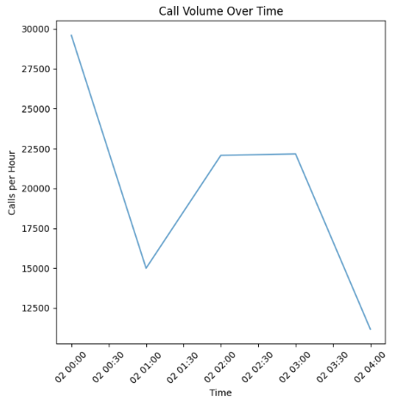
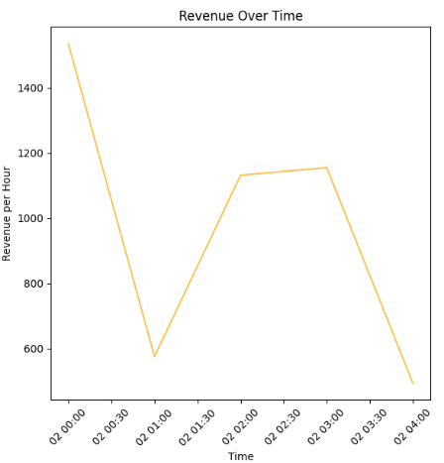
Dataset Details
Hourly call traffic with a dramatic drop from 30k to 15k calls, followed by partial recovery reveals when network experiences traffic surges and drops, forming the basis for volume-based anomaly detection
Inverse relationship between call volume and success rate shows network congestion and capacity issues during peak periods.
Revenue fluctuations directly correlate with traffic patterns, indicating business impact of network performance issues.

Slide 16
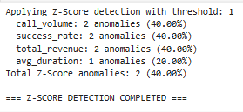
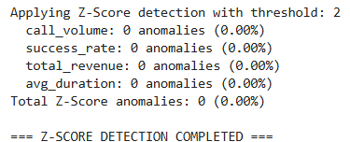
Z-score Anomalies
Z-Score threshold = 2
0 anomalies found data is very consistent patterns with no extreme outliers
Reason:
Very stable network performance
Limited time range
Z-Score threshold = 1
Z-Score (40%): Most sensitive, catches moderate deviations

Slide 17
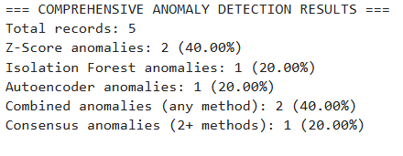
Comprehensive Results -
Isolation Forest anomalies: 1 (20.00%) Flagged one period (20%) as an outlier based on how “isolated” its multivariate feature values are.
Autoencoder anomalies: 1 (20.00%) The autoencoder identified one period where reconstruction error exceeded the threshold, signaling a pattern break.
Combined anomalies (any method): 2 (40.00%) Across all three techniques, two unique periods were flagged by at least one method.
Consensus anomalies (2+ methods): 1 (20.00%) Only one period was flagged by two or more methods, giving you highest confidence that it truly represents an anomaly.

Slide 18
Anomaly Results
Multiple anomaly detection methods (Z-Score, Isolation Forest, Autoencoder) flagged abnormal behavior in call volume, success rate, and revenue.
The first row - Z-Score method only
The second row - All three methods
Business Impact:
low success rates
notable revenue drops
Z-Score threshold defines how strict or lenient the model is when defining a data point as “anomalous”.

Slide 19
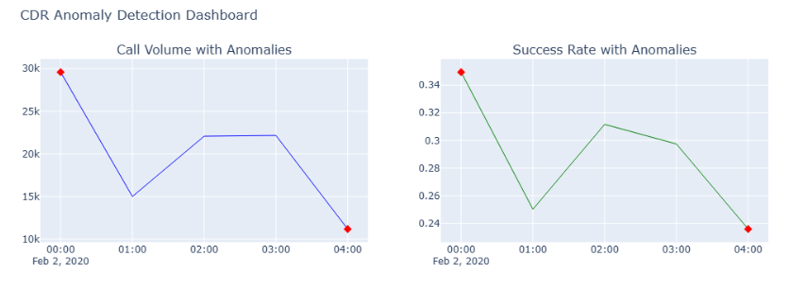
Visual Representation
Call Volume Plot:
Signifies: Network capacity issues or demand fluctuation
Success Rate Plot:
Same timing: Anomalies align with call volume issues
Signifies: Service quality degradation during high-stress periods which showcases high call volumes.

Slide 20
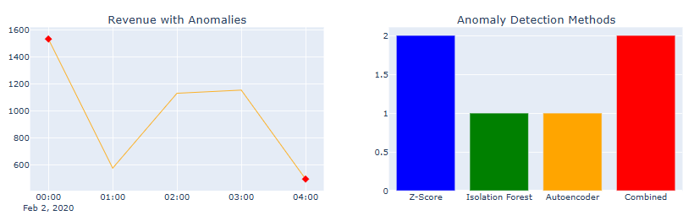
Visual Representation
Revenue Plot:
Pattern: High revenue (1,500) → sharp drop (600) → recovery → final drop (500)
Business impact: 60-70% revenue loss during anomalous periods
Signifies: Higher revenue during anomalies: +6.4% increase
Possible explanations:
Premium/international calls during incidents
Emergency call surcharges
Higher-value customers affected differently
Method Comparison:
Z-Score: 2 detections (most sensitive)
Isolation Forest: 1 detection (moderate)
Autoencoder: 1 detection (moderate)
Combined: 2 total unique anomalies

Slide 21
3. Object Clustering and Geospatial Analysis
Focus on clustering cell towers based on their geographic locations and network performance attributes.
Use geospatial analysis to study coverage, density, and signal gaps across regions.
Apply KMeans clustering to group towers spatially and identify coverage zones.
Generate hexbin plots and interactive Folium maps for visualizing cluster patterns and throughput density.
The goal is to support optimized tower placement and congestion management using data-driven insights.

Slide 22
Methodology
• Data Preparation
– Cleaned ~137k rows, 35 attributes
– Derived features: traffic_density, coverage_efficiency, throughput
• Clustering Method
– K Means (scalable clustering)
• GeoSpatial Analysis
– Hexbin maps → visualize throughput density
– Folium interactive maps → explore cluster patterns
– Coverage metrics (under/over coverage, ratio) → assess network efficiency

Slide 23
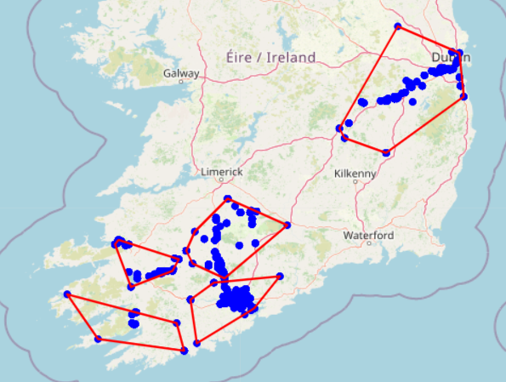
Results: Geographic Clustering
• Geographic Clusters
– Towers grouped into clusters based on coordinates
– Identifies demand centers vs. low-utilization zones

Slide 24
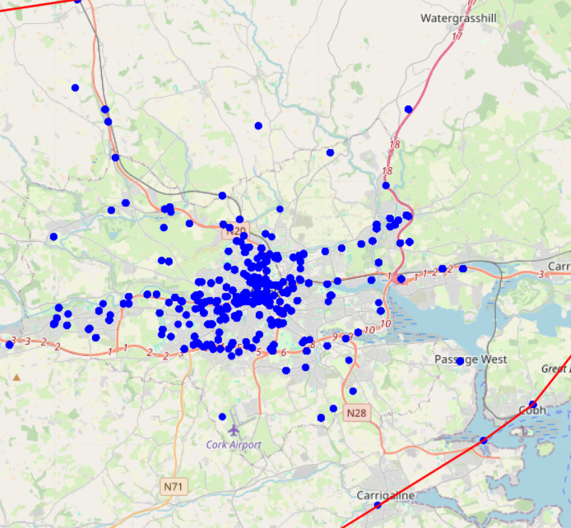

Slide 25
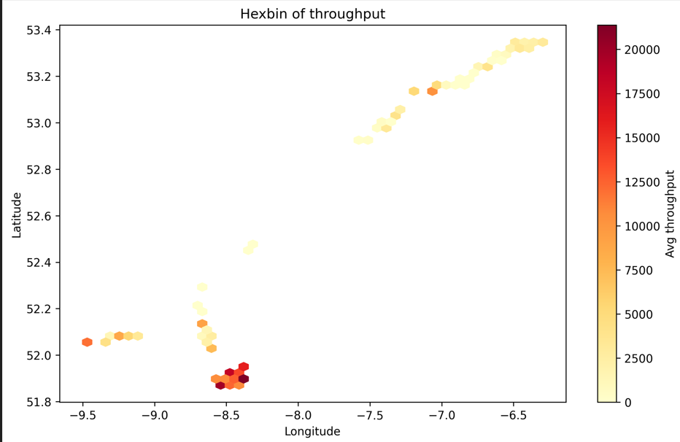
Results: Throughput based Clustering
• Hexbin of Throughput
– Displays average throughput density across Ireland
– Darker hexes = higher traffic concentration
– Helps spot regional hotspots (urban demand)

Slide 26
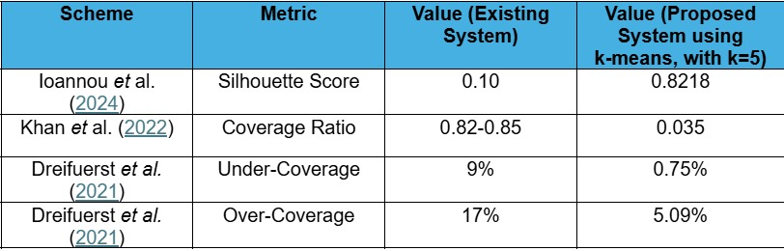
Results: Evaluative Metrics

Slide 27
Conclusion
- Predictive analytics can improve network planning
- Proactive upgrades reduce service disruptions
- Geospatial analysis identifies hotspots
- Serverless AWS pipeline enables scalable deployment (In Progress)
- Future Work: Reinforcement Learning for better capacity management

Slide 28
Any questions?
Ask away!

Slide 29
Thank you

